Slide 1
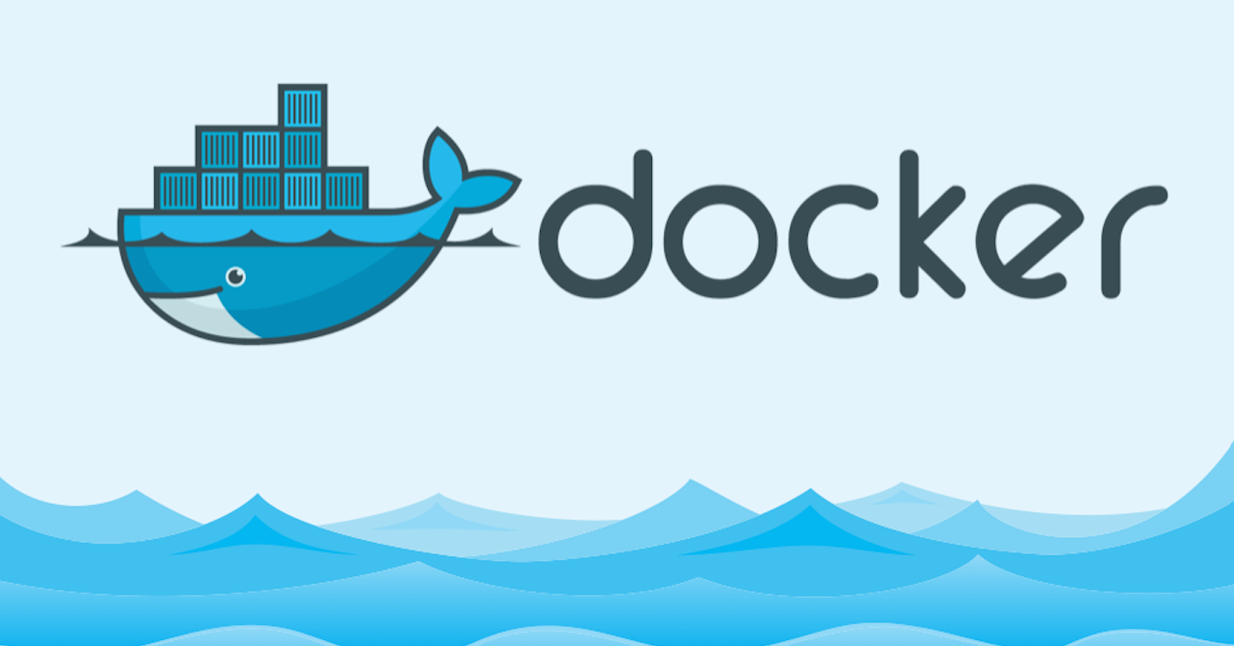
Docker CE and EE summary
The open platform to build, ship and run any application anywhere

Slide 2
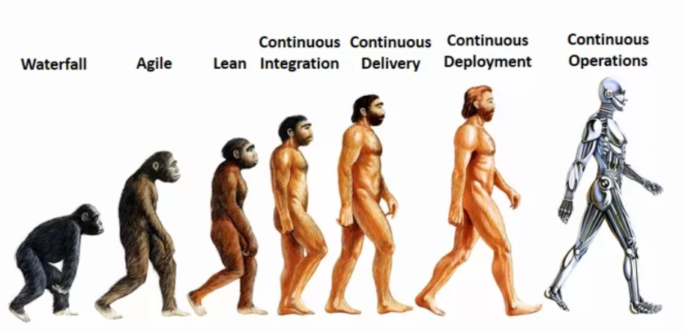
About me
14+ Engineering experience (Cisco Systems, VMware )
Continuous Operations freak and AWS enthusiast

Slide 3
Session Logistics
3 hours (exercising time included)
No docker experience required
Familiar with microservices architecture is a plus

Slide 4
Agenda
What is Docker
Benefits
Evolution of Docker
Docker CE and EE
Docker EE
Cluster Components
Load Balancing
Service Discovery
HRM
Lifecycle
Subscription Tiers

Slide 5
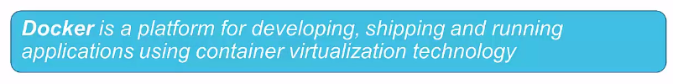
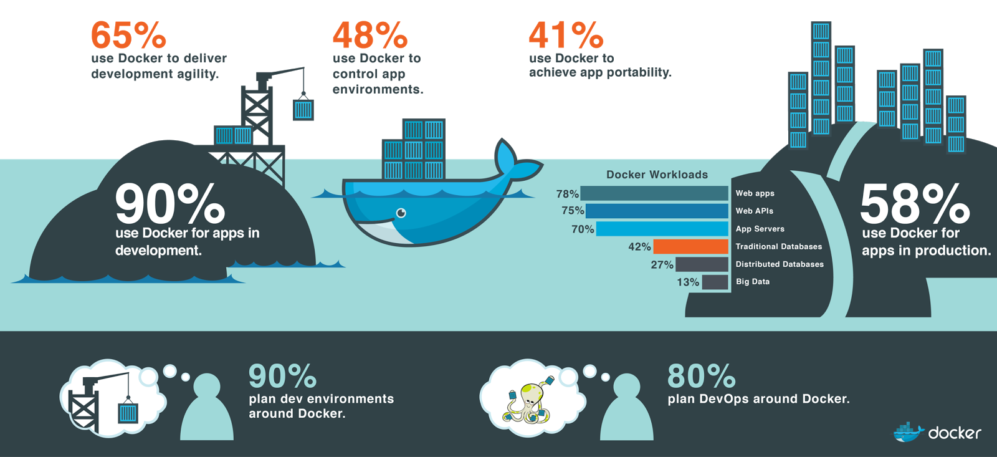
What is Docker

Slide 6
Benefits of Docker
Separation of concerns
Developers focus on building apps
QA focus on testing
System admins focus on deployment
Fast development cycle
Application portability and
Build in one environment, test and ship to another
Scalability spin-up new container if needed
Easily spin-up new container on demand
Cost efficiency

Slide 7

Evolution of the Docker Platform
Single purpose
Linux developer community

Slide 8
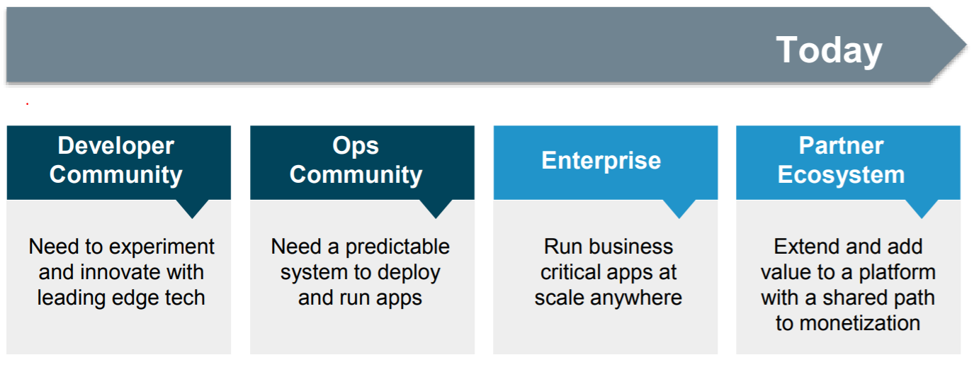
Evolution of the Docker Platform
Many purposes, users and infrastructure

Slide 9
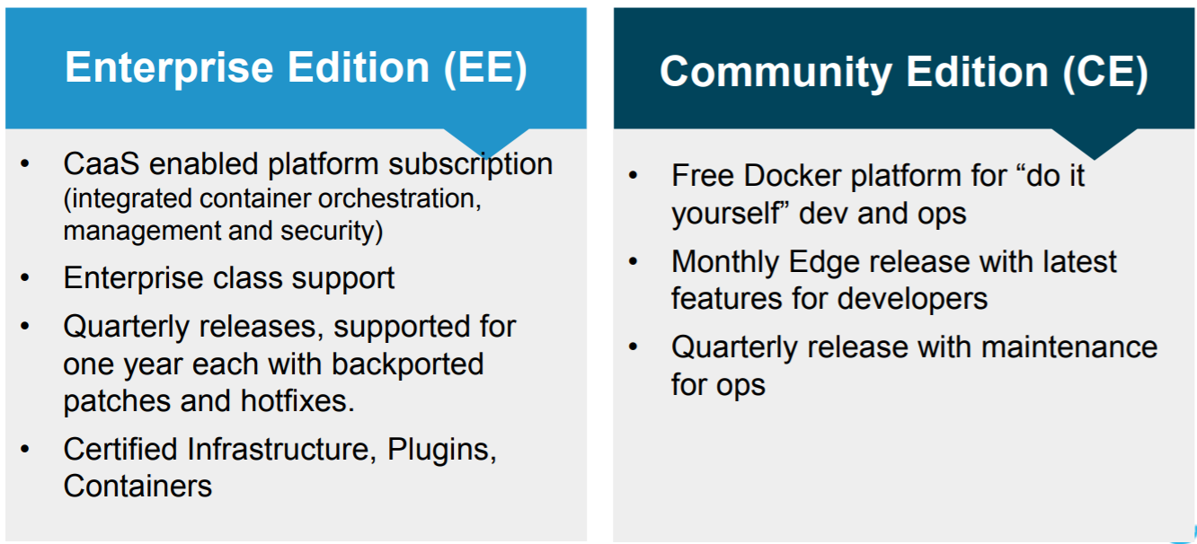
Docker Enterprise Edition (EE) and Community Edition (CE)

Slide 10
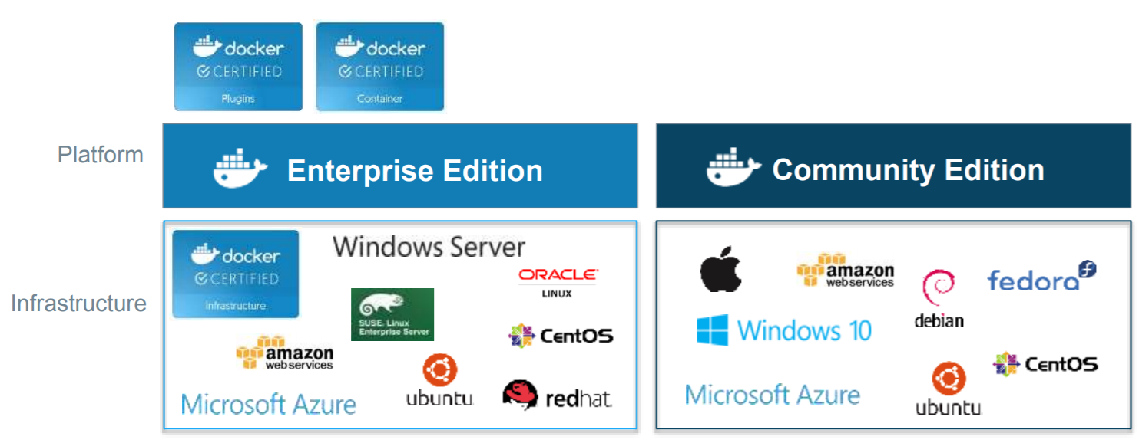
Editions and certification
NEW Certification program for Infrastructure, Plugins and Containers

Slide 11
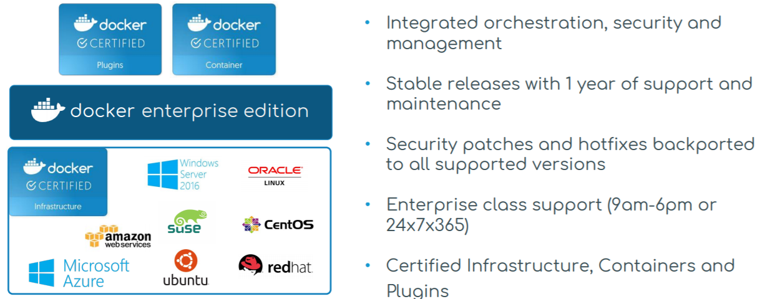
Docker Enterprise Edition (EE)
CaaS enabled platform for the modern software supply chain

Slide 12
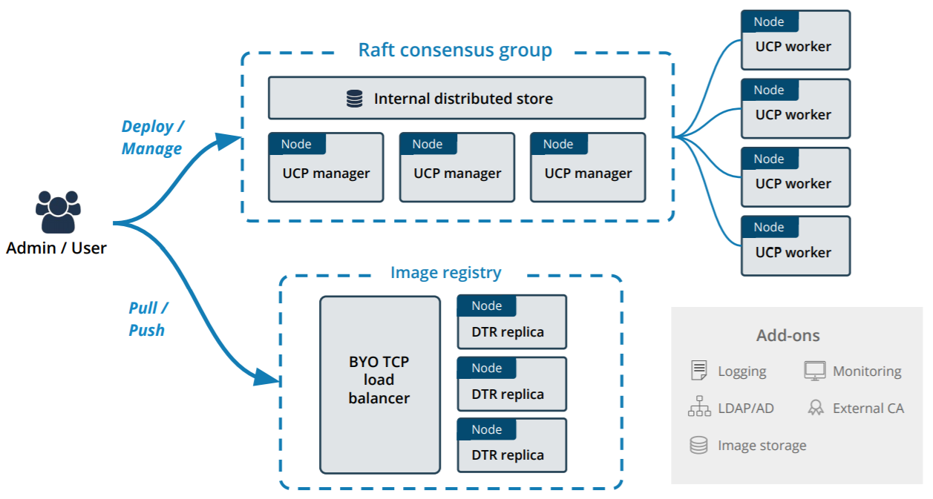
Docker EE Architecture

Slide 13
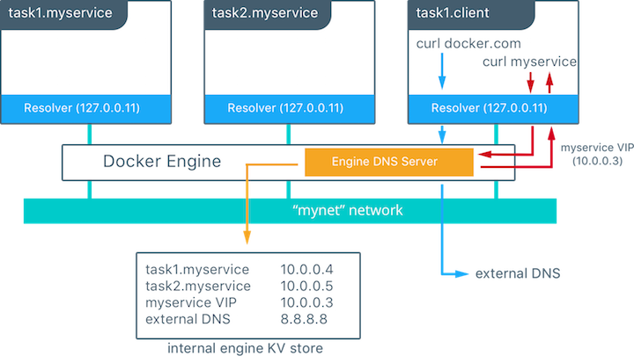
Service Discovery (DNS style)

Slide 14
Internal Load Balancing
When services are created in a Docker Swarm cluster, they are automatically assigned a Virtual IP (VIP) that is part of the service's network. The VIP is returned when resolving the service's name. Traffic to the VIP is automatically sent to all healthy tasks of that service across the overlay network.
This approach avoids any client-side load balancing because only a single IP is returned to the client. Docker takes care of routing and equally distributes the traffic across the healthy service tasks.

Slide 15
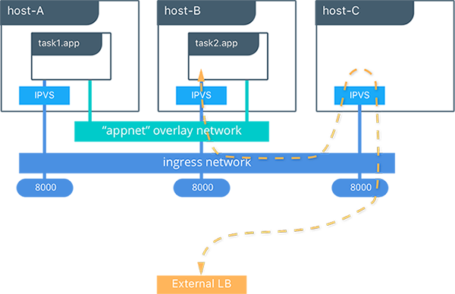
Load Balancing (Routing Mesh) SWARM style

Slide 16
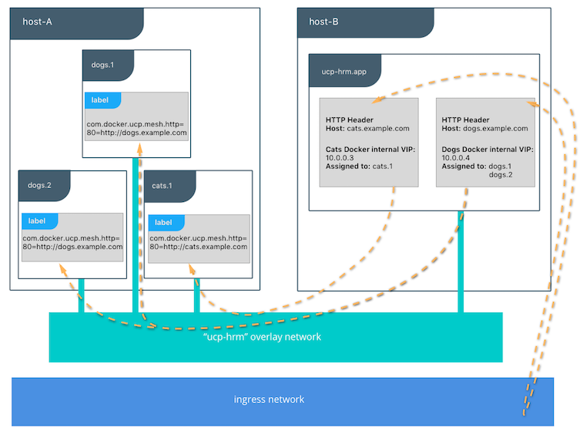
HRM

Slide 17
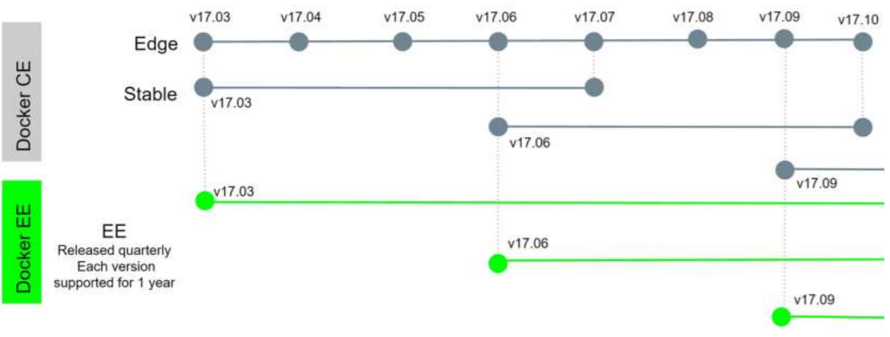
Lifecycle
Squaring the circle: Faster releases and better stability

Slide 18
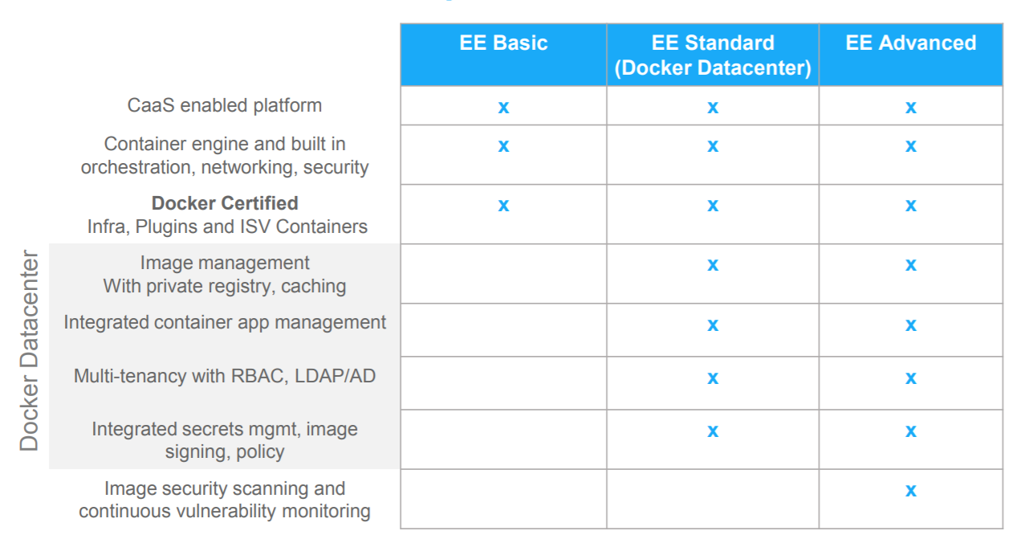
Docker EE Subscription Tiers

Slide 19
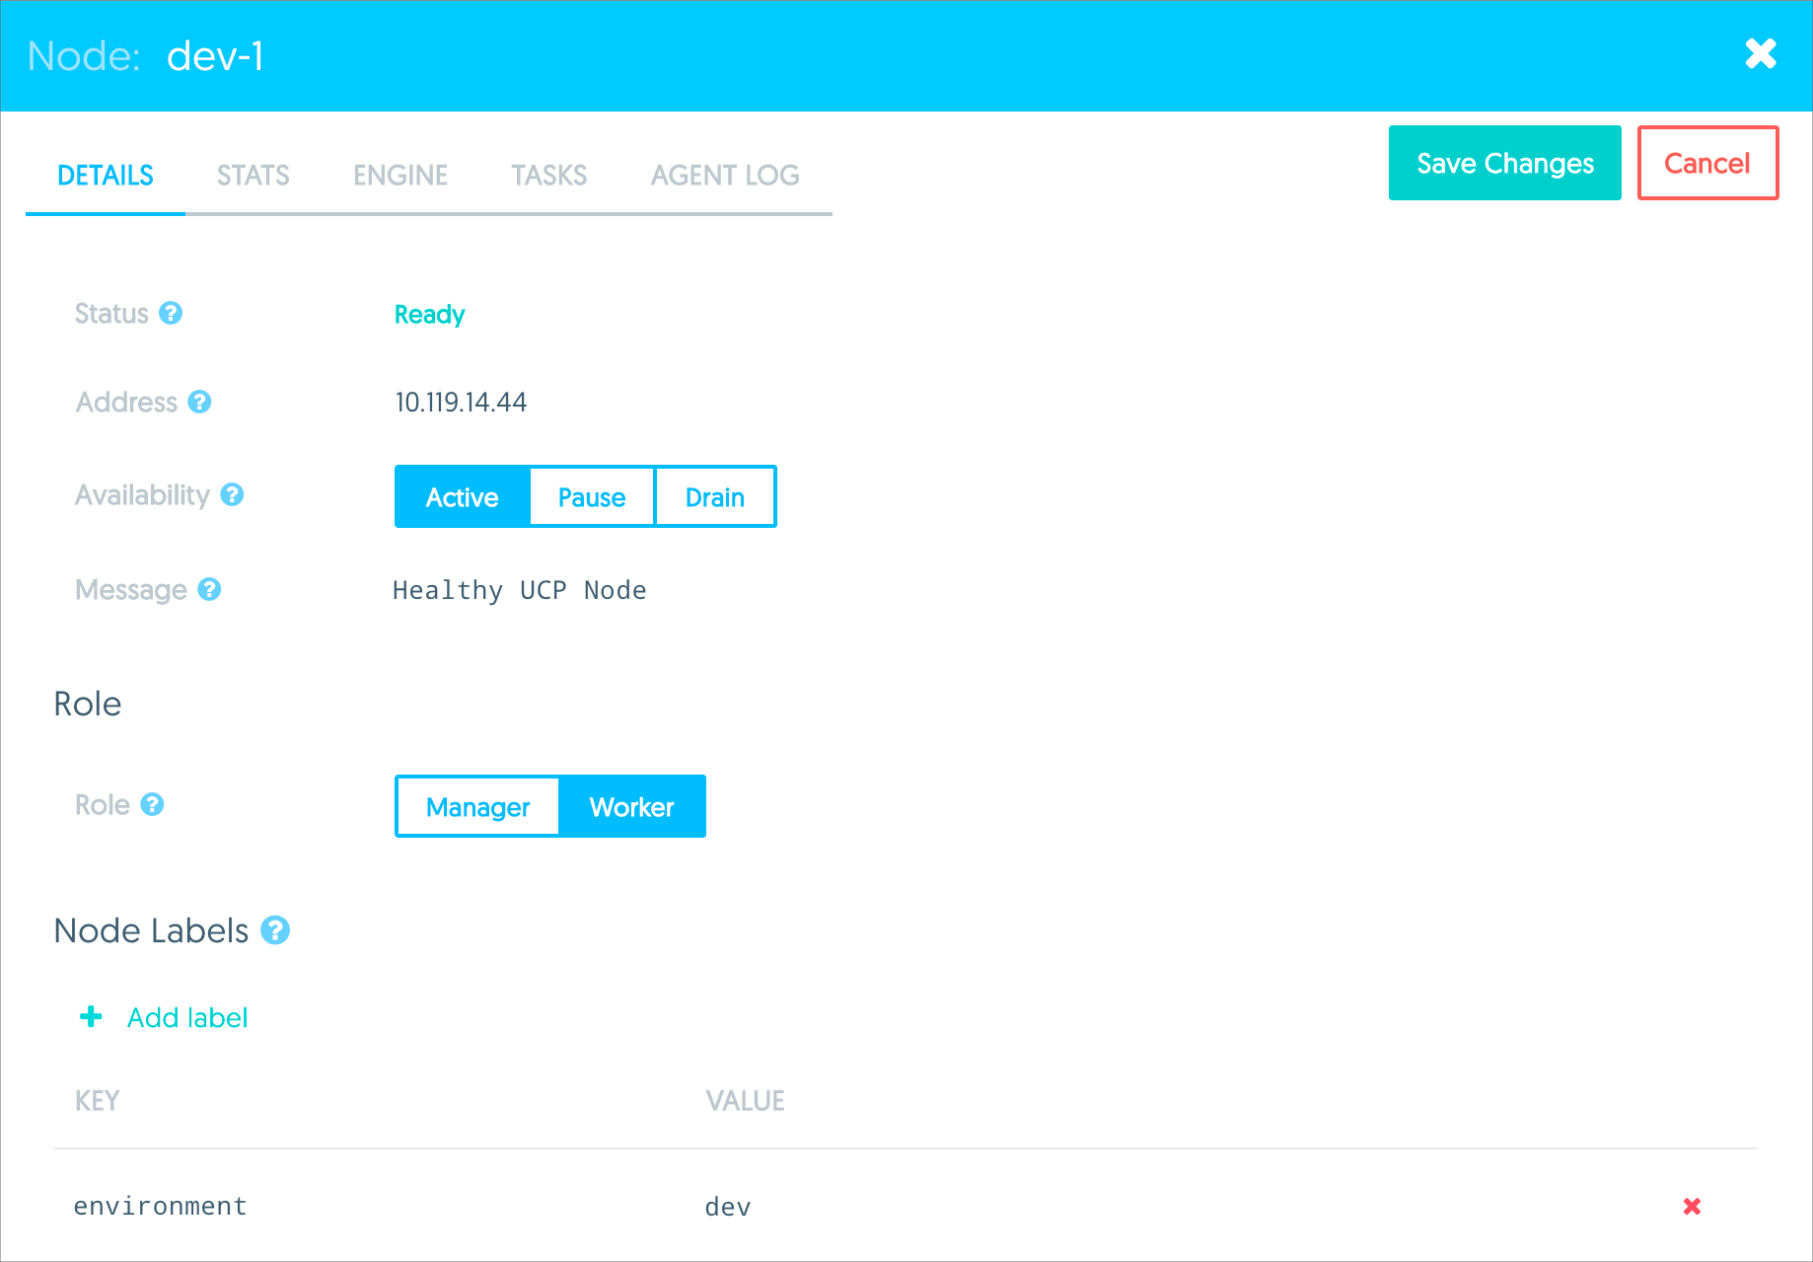
Demo

Slide 20


Slide 21
References
Docker EE
https://www.docker.com/enterprise-edition
Docker CE vs EE
https://www.cio.com/article/3176713/open-source-tools/docker-draws-distinctions-between-enterprise-and-community-editions.html
Google ☺

